Slide 1
Data Cleaning &
Visualization
Pearson Correlation Heatmap | Outlier Detection
MSE803 Data Analytics — Week 3, Activity 2

Slide 2
Dataset Overview — Raw Data Issues
Dataset at a Glance
Issues Identified
File: messy_dataset_Mukesh.csv Rows: 10 Columns: 6 Columns: ID, Name, Age,
Country, Salary, Join Date
Duplicate row
Bob (ID=2) split across 2 rows
Text numbers
"thirty-eight" and "sixty five thousand"
Missing values
Age ×2, Salary ×2, ID ×1, Name ×1, Country ×1
Invalid date
"2019-13-01" — month 13 does not exist
Inconsistent country
"AU" and "AUS" represent the same country
8
1
1
Missing
Values
Duplicate
Rows
Invalid
Dates
MSE803 Data Analytics | Week 3 Activity 2 | 2511-YCCIA-MSE

Slide 3
Data Cleaning — Steps Applied
Issue Found | Fix Applied
Duplicate Bob (ID=2) — 2 rows, split data | Merged rows: kept Age from row 1, Salary from row 2
"thirty-eight" / "sixty five thousand" | Converted to numeric: 38 / 65,000
Missing ID (Eve) | Assigned next available ID: 11
Invalid date "2019-13-01" (month 13) | Parsed as 2019-01-13 using format %Y-%d-%m
"AU" vs "AUS" inconsistency | Standardised all to "AUS"
Missing Age / Salary (Heidi) | Filled with column median: 29.5 / $62,000
Missing Name (row 7) | Replaced with "Unknown"
Missing Country (Grace) | Filled with mode: "NZ"
MSE803 Data Analytics | Week 3 Activity 2 | 2511-YCCIA-MSE

Slide 4
Cleaned Dataset — Result
ID | Name | Age | Country | Salary | Join Date
1 | Alice | 25 | NZ | $55,000 | 2020-01-15
2 | Bob | 30 | NZ | $60,000 | 2020-02-20
4 | Charlie | 35 | AUS | $72,000 | NaT
5 | David | 38 | NZ | $68,000 | 2019-11-01
11 | Eve | 29 | AUS | $59,000 | 2019-01-13
7 | Unknown | 40 | NZ | $65,000 | 2018-05-30
8 | Grace | 22 | NZ | $64,000 | 2021-07-25
9 | Heidi | 29.5* | AUS | $62,000* | 2021-07-25
10 | Ivan | 27 | NZ | $58,000 | 2019-03-15
* Heidi's Age and Salary were missing — filled with column median | NaT = no date available in source data
MSE803 Data Analytics | Week 3 Activity 2 | 2511-YCCIA-MSE

Slide 5
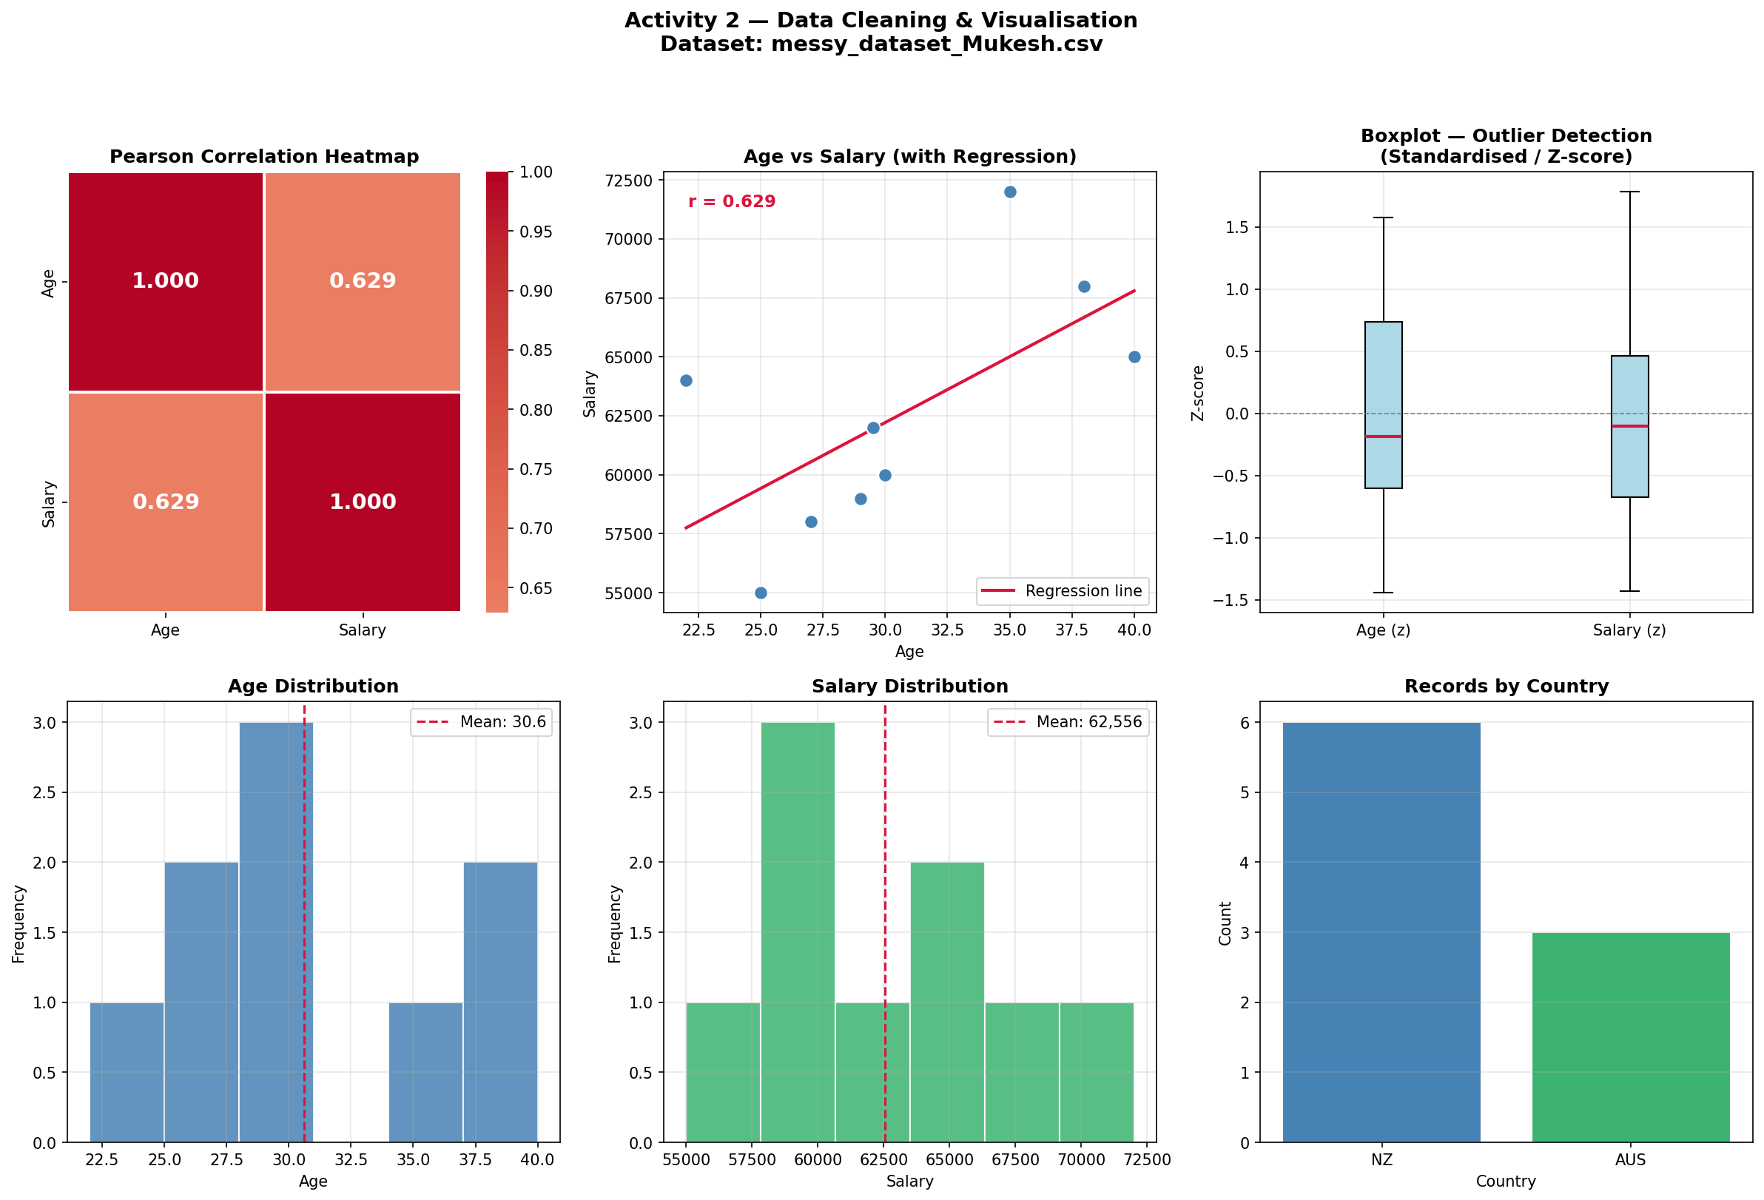
Pearson Correlation Heatmap
Pearson Formula
r = 0.882
Strong Positive Correlation
Interpretation
r = +1.0 Perfect positive
r = 0.882 Strong positive
r = 0.0 No correlation
r = −1.0 Strong negative
Key Insight
As Age increases, Salary tends to increase. The regression line confirms this upward trend.
MSE803 Data Analytics | Week 3 Activity 2 | 2511-YCCIA-MSE

Slide 6
Outlier Detection — IQR Method
Age
Salary
Q1
27.0
Q1
$59,000
Q3
35.0
Q3
$65,000
IQR
8.0
IQR
$6,000
Lower bound
15.0
Lower bound
$50,000
Upper bound
47.0
Upper bound
$74,000
No Outliers Detected
No Outliers Detected
IQR Rule: values below Q1 − 1.5×IQR or above Q3 + 1.5×IQR are flagged as outliers
MSE803 Data Analytics | Week 3 Activity 2 | 2511-YCCIA-MSE

Slide 7
Summary & Key Insights
9
Issues Cleaned
0.88
Pearson r = 0.882
NZ
NZ Majority
Duplicates, text values, missing data, invalid dates
Strong positive correlation between Age and Salary
6 out of 9 employees are based in New Zealand
0
No Outliers Found
22–40
Age Range: 22–40
!
Correlation ≠ Causation
IQR method confirmed clean bounds for Age & Salary
Salary range: $55,000 – $72,000
Age and salary trend does not confirm a causal link
Thank you | MSE803 Data Analytics — Week 3 Activity 2 | 2511-YCCIA-MSE

